Slide 1





Technologies Used
Spring Boot
Backend domain APIS are developed
using spring boot based microservices
Angular 9
Powered by NPM, Angular ver. 9 was used
With integration of UD citi components
To achieve modular design and effective UI
interface
Travel Suppression
Bootstrap
To achieve responsive and well aligned
UI for multiple device compatibility
JUnit
Code coverage for G4G compliance
Was achieved thorough test cases
Developed using Junit 5
Git ( Bitbucket )
Git was used as version control system managed
Through bitbucket for code tracking.

Slide 2
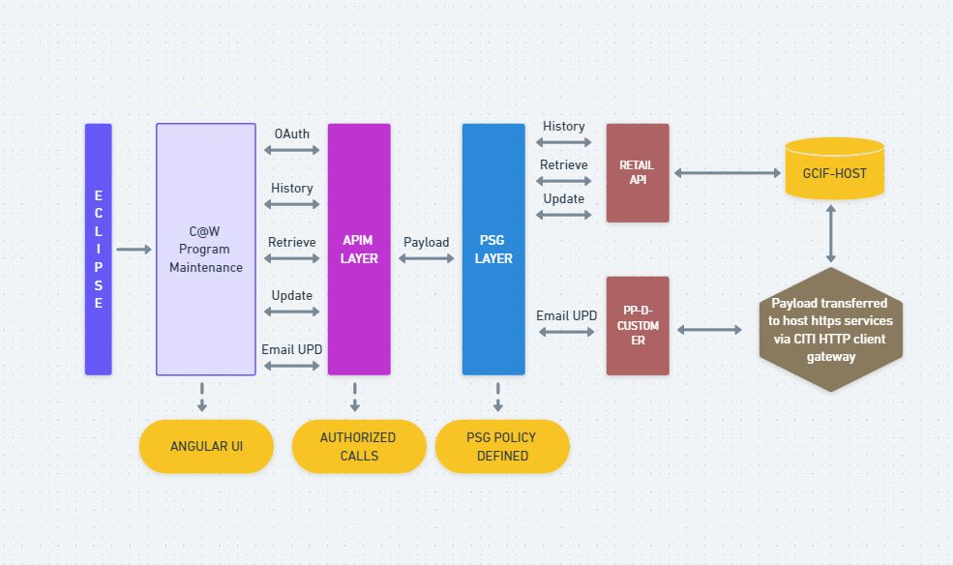
Application Flow Chart

